Slide 1

Online Sales Forecasting
Haolong Liu
Taichen Zhou
Yichen Huang

Slide 2



Agenda
Problem and Business Value
Project Milestones and Timeline
Data Sources
Data Preprocessing
Data Analysis
Pre-Modeling
Model
Results
Challenges and Future Steps

Slide 3




Introduction
The Online Retail data set contains all the transactions occurring for a UK-based and registered, non-store online retail between 01/12/2009 and 09/12/2011. The company mainly sells unique all-occasion giftware. Many customers of the company are wholesalers.

Slide 4

Problem
Value Creation
Bad debt appears multiple times in the sales data of 2 years period and supply chain can be better improve when applying analysis and forecasting techniques are implemented
Reduce Inventory Cost
Objective
Apply Forecasting and Machine Learning Techniques to Predict Daily Sales in the Future
Optimize Supply Chain
From:
To:
Feb 1st, 2023
Mid-term
Increase Sales Profit

Slide 5
Timeline
Data Exploration
Forecasting techniques and ML Model Shallow Taste
To be continued…
Milestone 1
Milestone II
Deliverable 1
Milestone 3
Deliverable II
Data Preprocessing and Data Analysis
The Notes pane is a box that appears below each slide. Tap it to add notes.

Slide 6
Data
The data is downloaded from UCI Machine Learning Repository, Online Retail Data.
Attribution information:
InvoiceNo: Invoice number. A 6-digit integral number uniquely assigned to each transaction. If this code starts with letter 'c', it indicates a cancellation
StockCode: Product code. A 5-digit integral number uniquely assigned to each distinct product
Description: Product (item) name
Quantity: The quantities of each product (item) per transaction
InvoiceDate: Invoice Date and time. The day and time when each transaction was generated
UnitPrice: Unit price. Numeric, Product price per unit in sterling
CustomerID: Customer number. A 5-digit integral number uniquely assigned to each customer
Country: Country name. The name of the country where each customer resides.

Slide 7
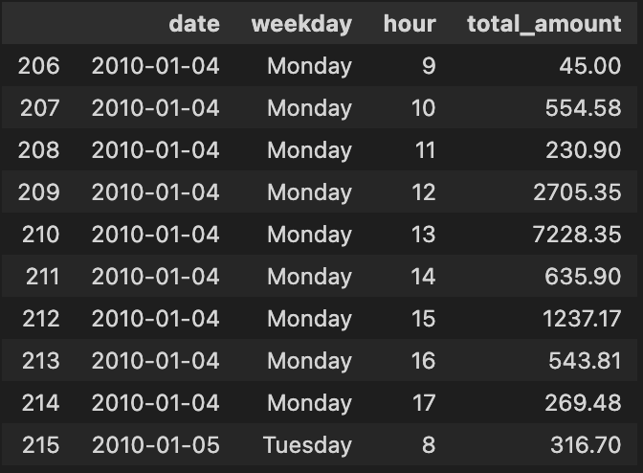
Data Preprocessing
Target Variable: quantity times the price for each transaction and renamed as “total_amount”
Only focus on the sales data in United Kingdom so data from other countries are dropped
Price and quantity which are lower than 0 for example, bad debt are dropped
Extract “weekday”, “hour” from the date attributes and dataset is grouped by hourly.

Slide 8
Data Analysis
Quarterly & Monthly Analysis
Weekly Analysis
Daily Transaction Analysis
Quarterly Sales
Monthly Sales
Monthly Sales Count
Add text, images, art, and videos.
Add transitions, animations, and motion.
Save to OneDrive, to get to your presentations from your computer, tablet, or phone.
Open the Design Ideas pane for instant slide makeovers.
When we have design ideas, we’ll show them to you right there.
Add text, images, art, and videos.
Add transitions, animations, and motion.
Save to OneDrive, to get to your presentations from your computer, tablet, or phone.
Open the Design Ideas pane for instant slide makeovers.
When we have design ideas, we’ll show them to you right there.

Slide 9
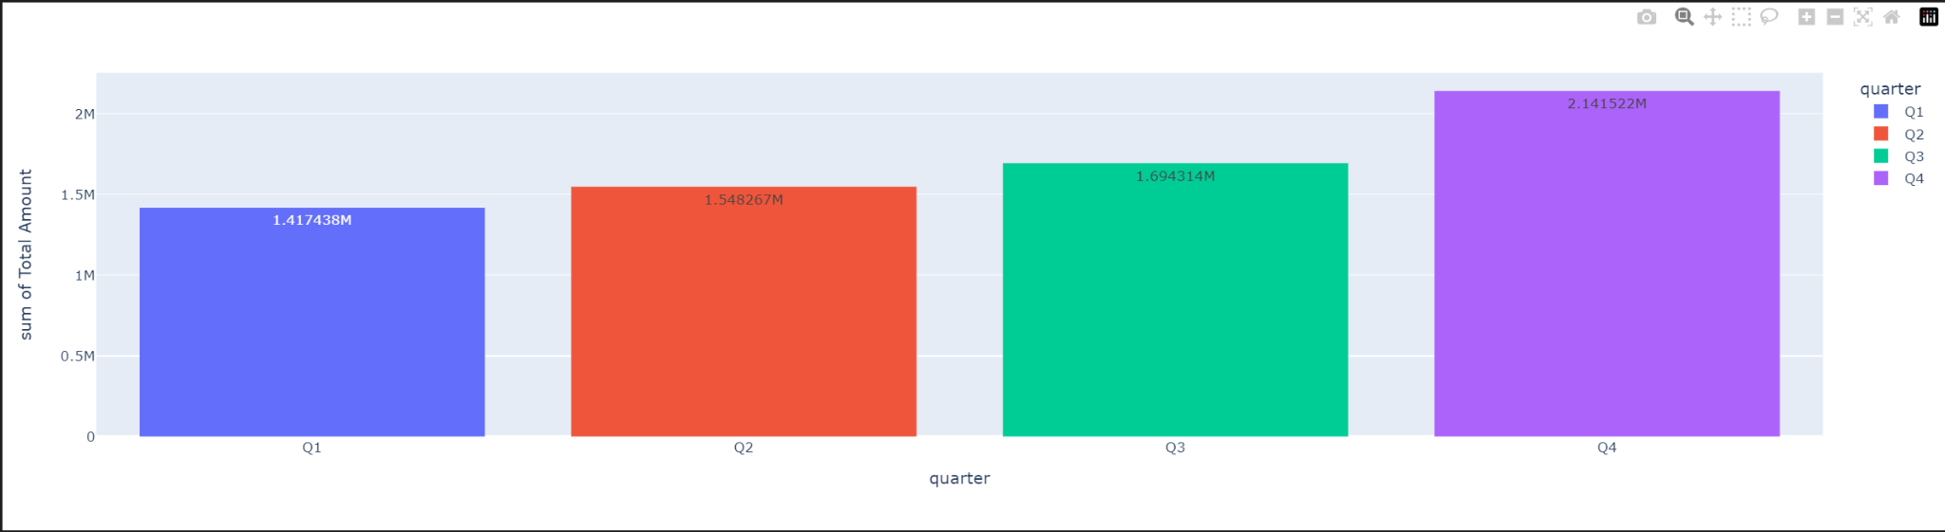
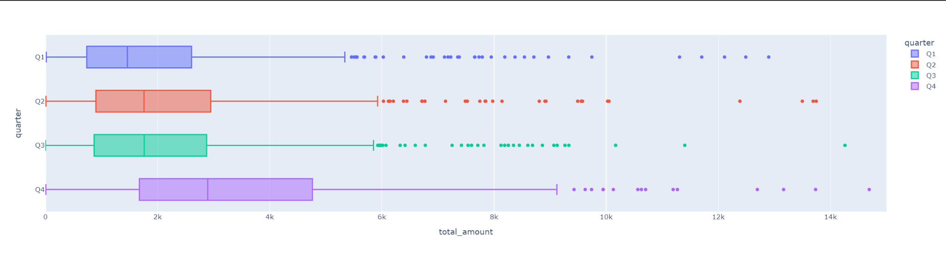
Quarterly Analysis
Although, Q4 has the lowest purchase frequency, it has the highest amount of sales amount.
We assume this pattern is highly related to the holiday season like Thanksgiving and Christmas.

Slide 10
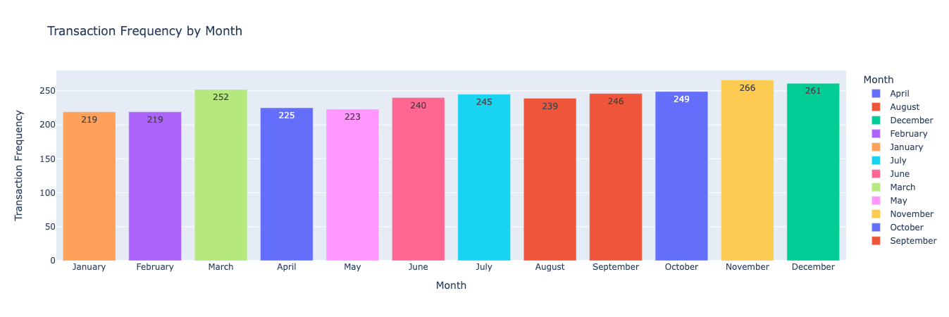
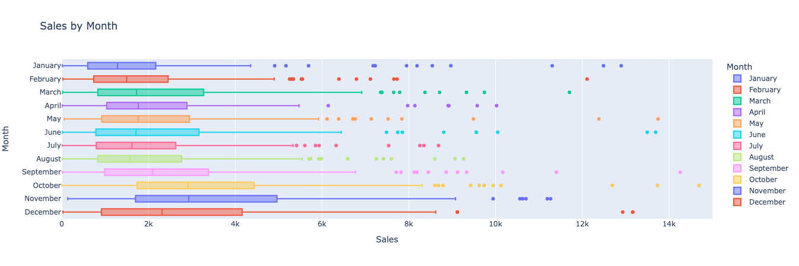
Monthly Analysis (2010)
From the Transaction Frequency by Month Chart, there is no significant difference or trend from January to December.
From the Sales by Month Box Plot, the sales from September to December is significantly higher than rest of the year.
Because the transaction frequency is about the same for each month, it is reasonable to conclude that the quantity of each order is higher from September to December.

Slide 11
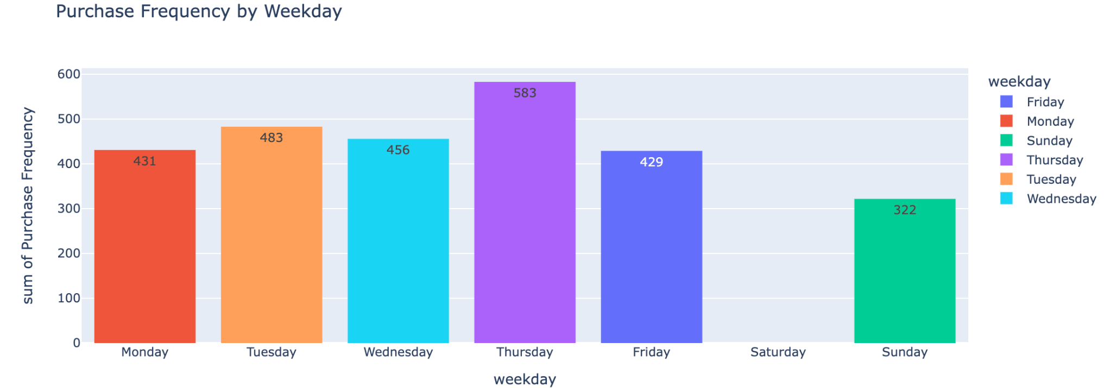
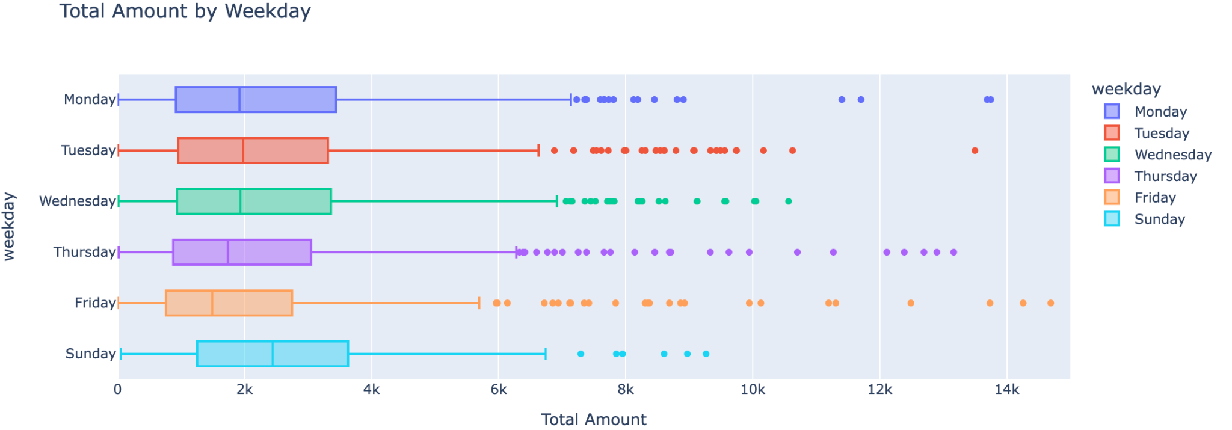
Weekday Analysis
From the histogram above, Thursday has the highest number of purchases and Sunday has the lowest.
From the boxplot below, Sunday has the highest median of total sales.
The data is missing for Saturday.
We speculate that Sunday as the end of the week might be the best time for buyers to prepare for the upcoming weekday.

Slide 12
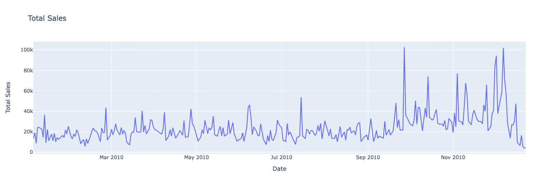
Daily Analysis

Slide 13
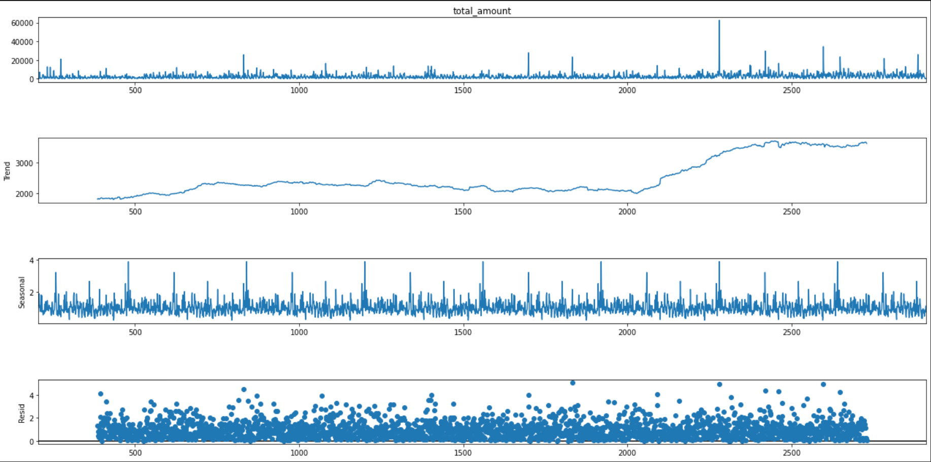
Pre-modeling
Seasonal Decomposition - Hourly
Before modeling, we did some analysis to the seasonality and trend of the original time-series dataset.

Slide 14
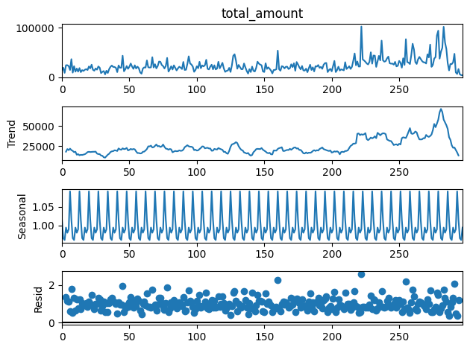
Seasonal Decomposition - Daily

Slide 15
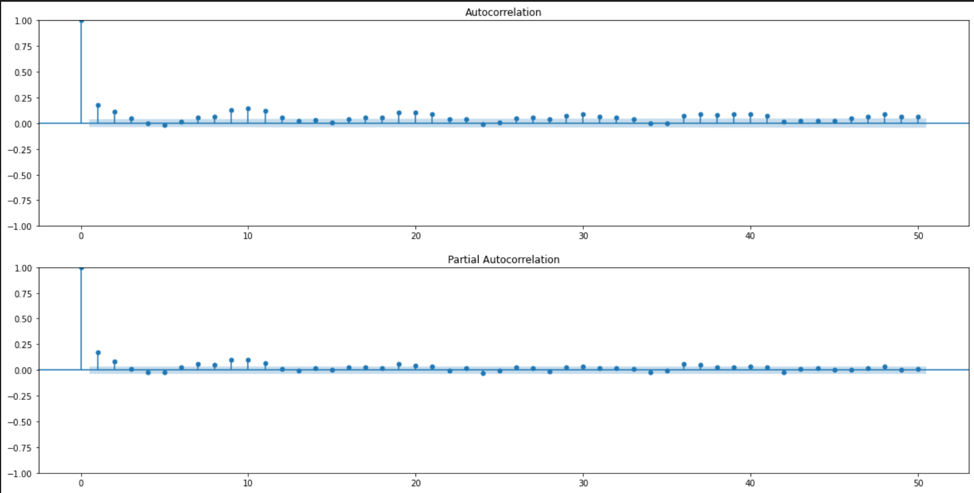
ACF and PACF Analysis
From the graphs of ACF and PACF, two graphs seem to have geometric decay but no clear cut-off. So, we assume that ARIMA or SARIMAX model might be a good fit to this dataset.

Slide 16
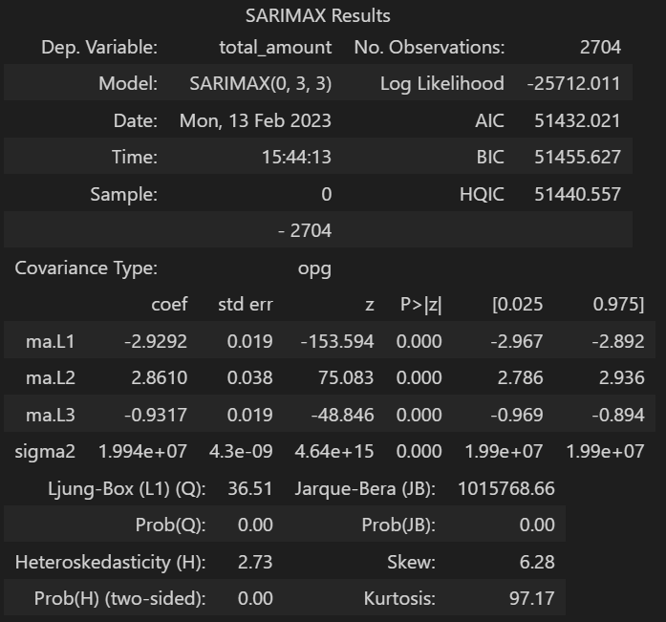

Model
After using gridsearch for the best combination of (p,d,q), (0,3,3) yield the best result while the AIC and BIC in this case are still really high. When using this model to predict the last 2 months of the dataset, mean absolute error is also high.
So, we are considering to combine some of the hours to a longer time period to decrease some data scrambling.
Also, more complex time-series models need to be implemented.

Slide 17
Content
SUBTITLE
SUBTITLE
Add text, images, art, and videos.
Add transitions, animations, and motion.
Save to OneDrive, to get to your presentations from your computer, tablet, or phone.
Open the Design Ideas pane for instant slide makeovers.
When we have design ideas, we’ll show them to you right there.

Slide 18
Table
 | Category 1 | Category 2 | Category 3 | Category 4
Item 1 | 4.5 | 2.3 | 1.7 | 5
Item 2 | 3.2 | 5.1 | 4.4 | 3
Item 3 | 2.1 | 1.7 | 2.5 | 2.8
Item 4 | 4.5 | 2.2 | 1.7 | 7

Slide 19

Summary
With PowerPoint, you can create presentations and share your work with others, wherever they are. Type the text you want here to get started. You can also add images, art, and videos on this template. Save to OneDrive and access your presentations from your computer, tablet, or phone.

Slide 20




Team
Name
Name
Name
Name
Title
Title
Title
Title

